Slide 1
JavaScript Tasks

Slide 2
Table of Contents
Basics
Functions
Conditional statements
Arrays
String
Math
Drop-down with cities
Image gallery
Guessing game
Word guessing game
Calendar

Slide 3
JavaScript Basics
4. Write a JavaScript program to find the area of a triangle where lengths of the three of its sides are 5, 6, 7
5. Write a JavaScript program to rotate the string 'w3resource' in right direction by periodically removing one letter from the end of the string and attaching it to the front.
10. Write a JavaScript program to calculate multiplication and division of two numbers (input from user)
31. Write a JavaScript program to find the largest of three given integers. Tasks source and solutions: https://www.w3resource.com/javascript-exercises/javascript-basic-exercises.php

Slide 4
2. Functions
1. Write a JavaScript function that reverse a number.
4. Write a JavaScript function that returns a passed string with letters in alphabetical order.
17. Write a JavaScript function to get the number of occurrences of each letter in specified string.
23. Write a JavaScript function to find the first not repeated character.
Tasks source and solutions: https://www.w3resource.com/javascript-exercises/javascript-functions-exercises.php

Slide 5
3. Conditional statements
1. Write a JavaScript program that accept two integers and display the larger.
4. Write a JavaScript conditional statement to find the largest of five numbers. Display an alert box to show the result.
7. Write a JavaScript program which iterates the integers from 1 to 100. But for multiples of three print "Fizz" instead of the number and for the multiples of five print "Buzz". For numbers which are multiples of both three and five print "FizzBuzz".
Tasks source and solutions: https://www.w3resource.com/javascript-exercises/javascript-conditional-statements-and-loops-exercises.php

Slide 6
4. Arrays
3. Write a JavaScript function to get the first element of an array. Passing a parameter 'n' will return the first 'n' elements of the array.
7. Write a JavaScript program to sort the items of an array.
12. Write a JavaScript program to compute the sum and product of an array of integers.
20. Write a JavaScript program to find duplicate values in a JavaScript array.
Tasks source and solutions: https://www.w3resource.com/javascript-exercises/javascript-array-exercises.php

Slide 7
5. String
3. Write a JavaScript function to split a string and convert it into an array of words.
5. Write a JavaScript function to convert a string in abbreviated form.
9. Write a JavaScript function to capitalize the first letter of each word in a string.
13. Write a JavaScript function to concatenates a given string n times (default is 1)
Tasks source and solutions: https://www.w3resource.com/javascript-exercises/javascript-string-exercises.php

Slide 8
6. Math
4. Write a JavaScript function to generate a random integer.
6. Write a JavaScript function to find the highest value in an array.
19. Create a Pythagorean function in JavaScript.
21. Write a JavaScript function that Convert an integer into a Roman Numeral in javaScript.
Tasks source and solutions: https://www.w3resource.com/javascript-exercises/javascript-math-exercises.php

Slide 9

7. Drop down with cities
Create javascript array containing cities.
Implement javascript functionality to create a Dropdown list (<select>) with these cities.
Create a simple form where user can add new city.
Once new city is added it should be also displayed in the Dropdown list

Slide 10
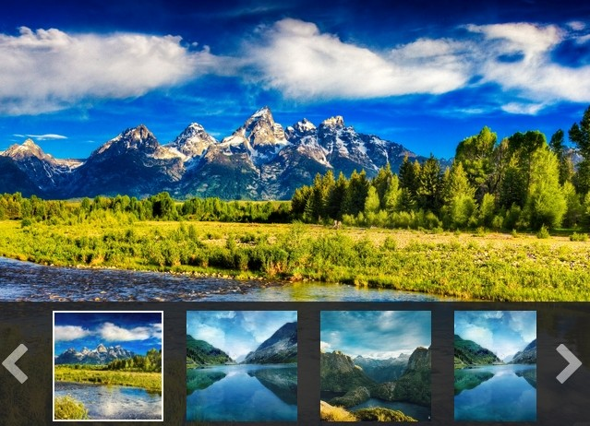
8. Image gallery
Create a json object containing list of images.
Images to be located in the images subfolder.
Create javascript code to:
Load first image on top of the page - “preview image”
Load images in a table-like structure below the main image (in 4 columns)
When image is clicked it should be displayed as a “preview image”

Slide 11
9. Number-guessing game
Write the init function to set up an event listener on the form. The event listener should pass the value of the input element to the check function.
Write the check function to accept a value from the event listener and check it against the targetNumber.
If the values match, call the showWin function
If the values do not match, call the showError function.
If the values do not match, and the player has made more than five guesses, call the showLoss function.
Write the showWin function to remove the form and any error message, and show a message telling the player they win.
Write the showError function to show a message telling the player their guess is incorrect.
Write the showLoss function to remove the form and show a message telling the player they lose.
Instructions and guidelines: https://codepen.io/rmurphey/pen/bEzoOZ

Slide 12
10. Word guessing game
This exercise creates a game that lets a player guess letters in a word.
When the game starts, the div#word should be populated with div.letter tiles, one for each letter in the target word.
As a player makes correct guesses, the tiles in the target word should be updated to show the correct guesses.
As a player makes incorrect guesses, the scoreboard should be updated to show each incorrect guess; also, the number of guesses remaining should be decremented.
After seven incorrect guesses, the player loses.
The player wins by guessing all of the letters in the word before running out of guesses. Instructions and guideline: https://codepen.io/rmurphey/pen/eJxrXx

Slide 13
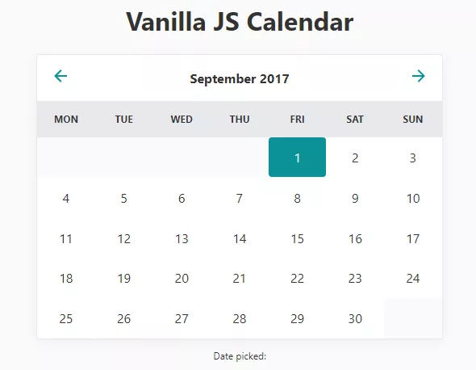
11. Calendar
Please implement calendar similar to one displayed on the picture.
Head row contains arrows to change month and display name of the currently selected month
Table head row contain days of the week
Table containing numbers for each day of the month placed correctly depending the weekday
Optionally: implement functionality for selection of date and display the selected date below calendar

